Slide 1
Mac users
PC users
Please sit together on this side of the room
Please sit together on this side of the room
Everyone
Please connect to the wifi
Create a new folder named “vagrant” on your desktop
Copy contents of flash drive to this folder
Notes:
Take an OS survey by show of hands

Slide 2
There’s an API for That
MARAC
April 20th, 2017
Lora J. Davis
Valerie Addonizio
Johns Hopkins University

Slide 3
Workshop aims
1.
Practical, real life application
Info-packed take-home
Resource-packed GitHub
2.
Assurances:
You are not alone
I didn’t get into this field for this either (but some of you may have!)
This is difficult and frustrating
You didn’t miss a flight; the airport turned into a space launch while you were in the parking lot

Slide 4
The 1-up learning experience
You can’t learn it all and we can’t teach it
Are you a 1?
We hope you’ll leave a 2.
Are you a 2?
We hope you’ll leave a 3.
Are you a 3?
We hope to give you new ideas, scripts, and momentum.

Slide 5
The Odd Couple
We are stronger and smarter together

Slide 6
9-10am
Intro/history

Slide 7
What is an API?
Complicated: A RESTful API is an application program interface (API) that uses HTTP requests to GET, PUT, POST and DELETE data.
(http://searchcloudstorage.techtarget.com/definition/RESTful-API)
Simple: You access it over the web, using URLs, and are limited to 3-4 simple commands.
Compare:
AT was a local application. To get at its data you needed MySQL Workbench to access a server and you needed to be careful.
AS is a web-based application. To get at its data you can also use Workbench, or, the API. Using the API means you won’t break it.

Slide 8
Get: One way street

Slide 9
Vocabulary sidebar
GET, POST, and DELETE are the three cornerstone commands for a RestfulAPI
We will use these terms throughout
Think of them as View, Save, and of course, Delete
All APIs allow GETs, some let you POST, and few allow you to Delete
ASpace does all three, but allows you to tailor permissions for each

Slide 10
API possibilities
Get data out
Do something to it
Put it back in
We are here

Slide 11
GET with GUI - ProPublica

Slide 12
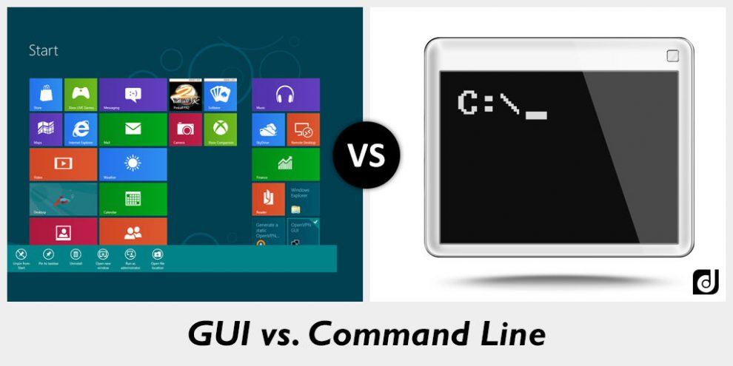
Vocabulary sidebar
GUI stands for Graphic User Interface, every program you use has a GUI
But in the programming/scripting world, there is also the command line/terminal
We will be using both
Image from http://www.differencebtw.com/difference-between-gui-and-command-line/

Slide 13
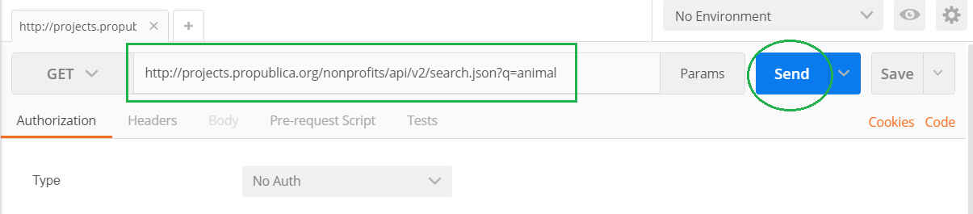
GET through a GUI
http://projects.propublica.org/nonprofits/api/v2/search.json?q=animal

Slide 14

https://projects.propublica.org/nonprofits/api/v2 | The address of the API. All requests must start with a similar string in order to point the request to where it needs to go. It essentially reads: go here.
/search.json | The search method set by the API. By appending this to the above URL, it essentially reads: go here, and search in a way that will output JSON.
? | Question marks denote that whatever follows is a parameter. Adding this to the above essentially reads: go here, and search, and use the following parameters. You can use more than one parameter.
q= | The parameter. The ProPublica API defines q as “A keyword search string. Searches using this parameter will search (in order) organization name, organization alternate name, city.”
animal | Any keyword supplied by the user. Go here, and use the keyword search parameter to search for animal, which will output as JSON.

Slide 15
GET with GUI - Chronicling America

Slide 16
GET with GUI - Twitter

Slide 17
GET with Script- ProPublica

Slide 18
Technical Sidebar:
Scripting set-up

Slide 19
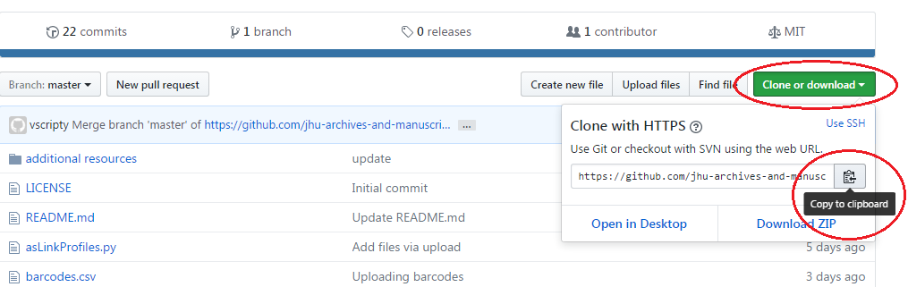
Technical Sidebar - Download Scripts
Navigate to GitHub.com
Search for “MARAC API Workshop”
Bookmark!

Slide 20
Technical Sidebar - cygwin
Mac
PC
Please open the terminal:
Use spotlight search to search for “Terminal”
OR, open your Applications folder, then open the Utilities folder. Open the Terminal application
Type python --version and hit enter
Please navigate to http://cygwin.com/install.html
(that’s c-y-g-w-i-n)
Download and bring up the installer
Valerie is going to walk you through the install

Slide 21
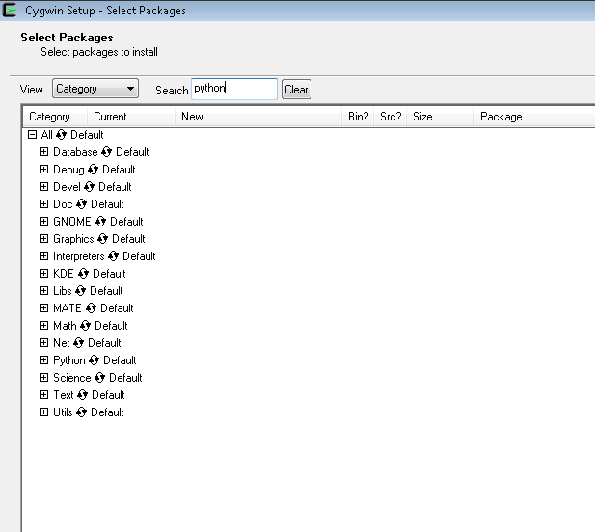
Windows users: Install cygwin
Asks you many questions, but keep defaults
Choose a download site: Any
Stop when you see Packages screen
Why? Because AS is Linux-based, and Windows can’t communicate to Linux without an intermediary; Macs have this built-in

Slide 22
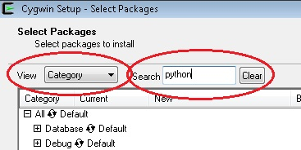
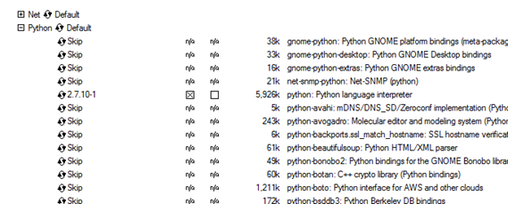
Install cygwin

Slide 23
Install cygwin
When you get to the Select Packages window, search for Python then unskip:
python2: Python 2 language interpreter 5,873k
python2-requests: Python HTTP/1.1 request module 84k
Search for git, expand Devel, unskip:
git: Distributed version control system 4,936k
Search for Openssh, under Net, unskip:
openssh: The OpenSSH server and client programs 750k
Next > Next

Slide 24
GET with a script
(This slide means they’ve already installed cygwin, downloaded the repo, and that Mac users have already checked their python version?)
Install beautify in Atom: Preferences > Install > search for “beautify”
Use by Packages > beautify
python proPublica.py

Slide 25
GET with a script
(This slide means they’ve already installed cygwin and that Mac users have already checked their python version?)
Install beautify in atom
pip install requests
Or
sudo pip install requests

Slide 26
Load, GET, and compare - VIAF

Slide 27
POST: Two way street (ArchivesSpace)

Slide 28
POST with GUI - ProPublica

Slide 29
POST with Script- Container profiles

Slide 30
Technical Sidebar:
vagrant install and vagrant up

Slide 31
User stories

Slide 32
Spare slides

Slide 33
https://api.twitter.com/1.1/search/tweets.json?q=johnshopkins

Slide 34
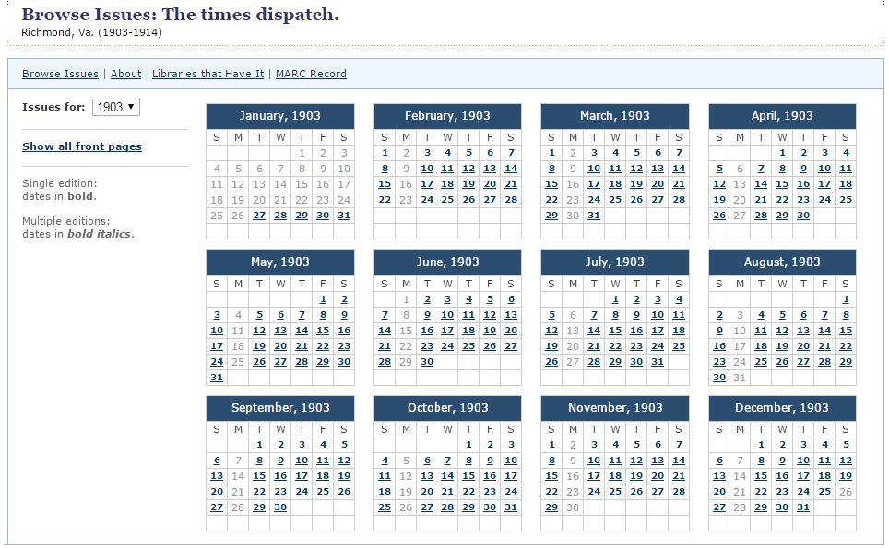
Web search versus API
Scenario: You wish to link to every digitized edition of a certain newspaper in Chronicling America.

Slide 35
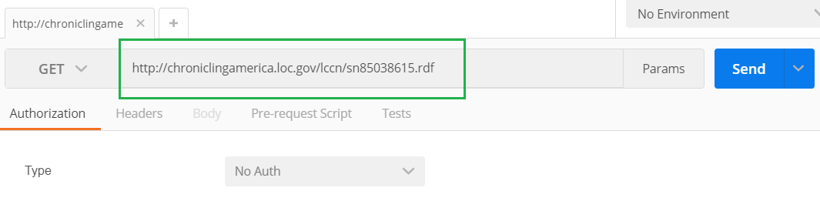
Web search versus API
Scenario: You wish to link to every digitized edition of a certain newspaper in Chronicling America.
http://chroniclingamerica.loc.gov/lccn/sn85038615.rdf

Slide 36
Web search versus API
Look at the address bar for any search in AS:
http://archivesspace.library.jhu.edu/search?utf8=✓&q=”Subseries”

Slide 37
Break!
Windows users must be back by 10:45

Slide 38
10:45-11:30

Slide 39
Install cygwin

Slide 40
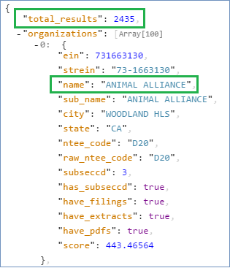
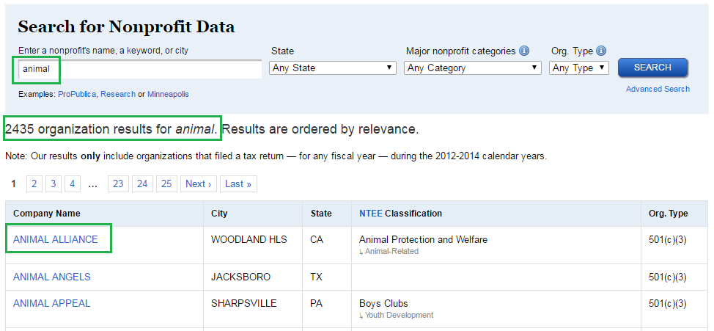
Web search versus API
You don’t get different results, you get the same results in a different format.

Slide 41
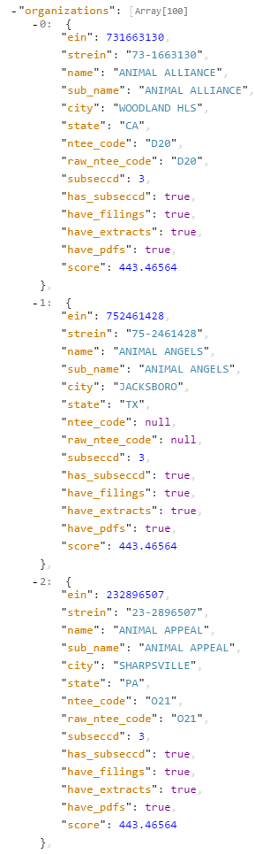
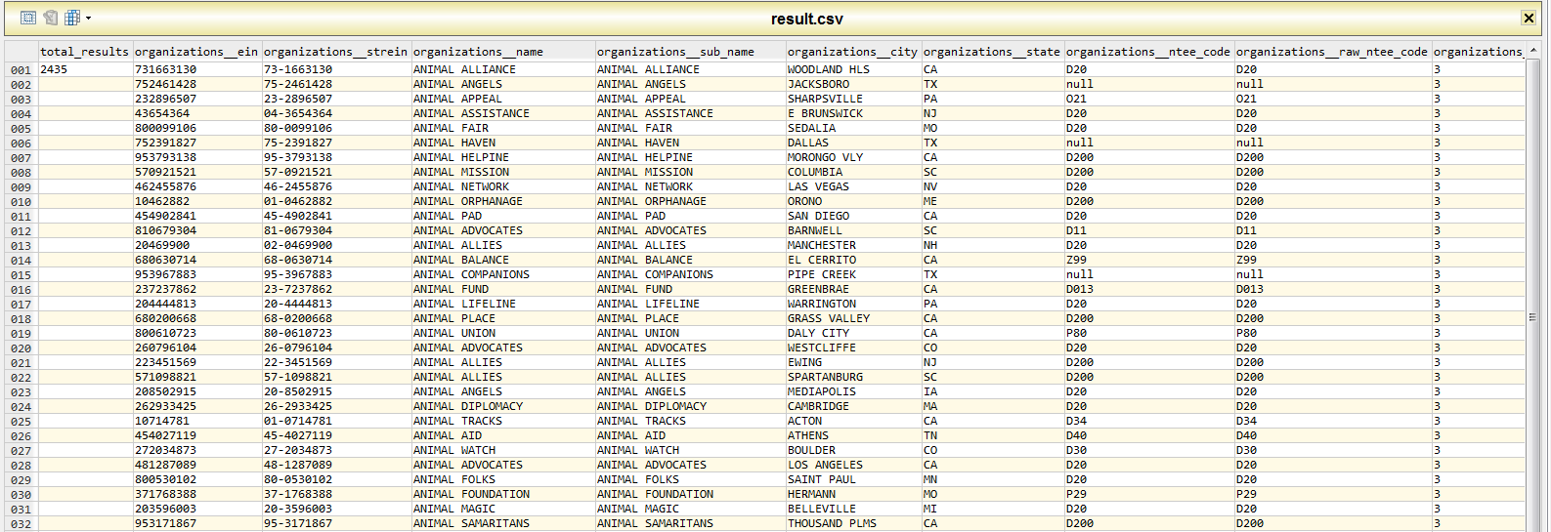
Converting these JSON search results to a CSV (spreadsheet) took less than 10 seconds.

Slide 42
1. Confirm vagrant version
Command line = vagrant -- version

Slide 43
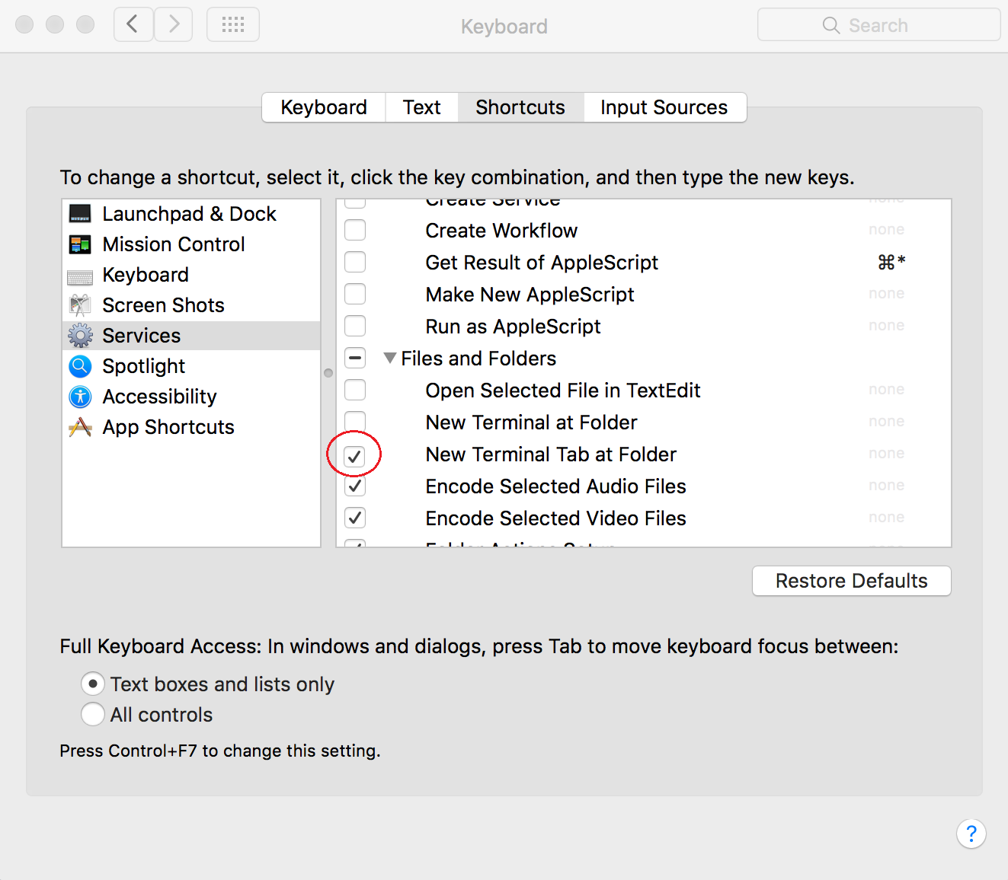
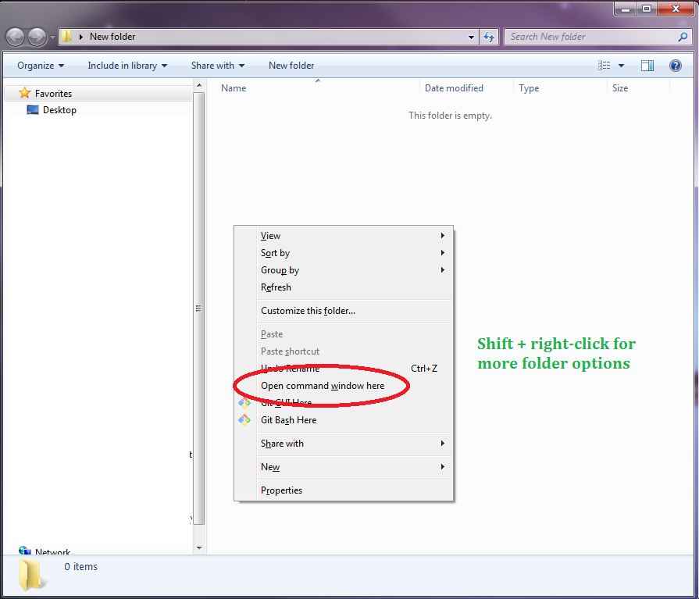
Mac
PC
Shift + right click

Slide 44
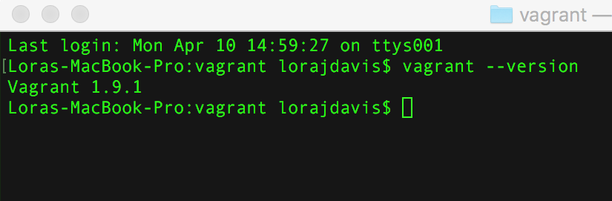
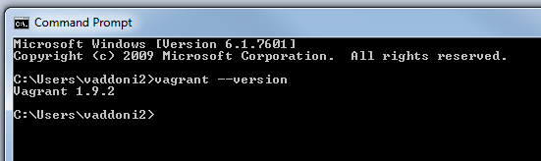
Mac
PC

Slide 45
Note to self: do this in morning, check in before lunch that everyone has done it
Create new folder on desktop called “vagrant”
Upload file from thumb drive to vagrant folder

Slide 46
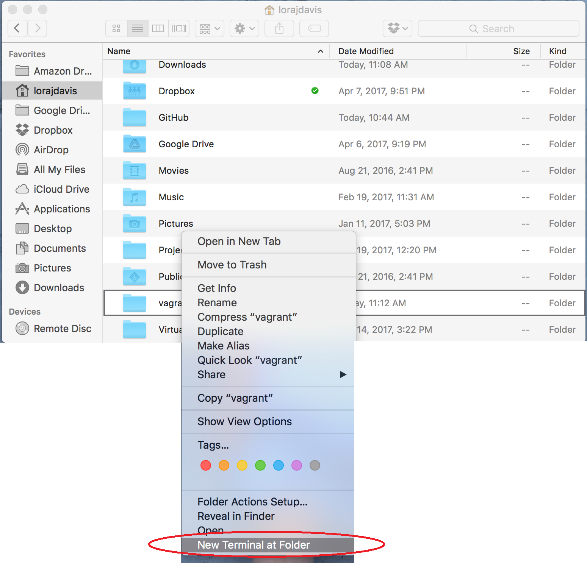
Mac
PC

Slide 47
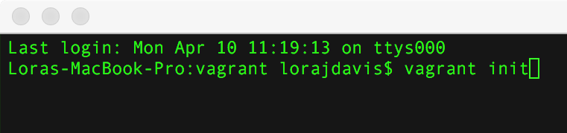

Mac
PC
vagrant init

Slide 48
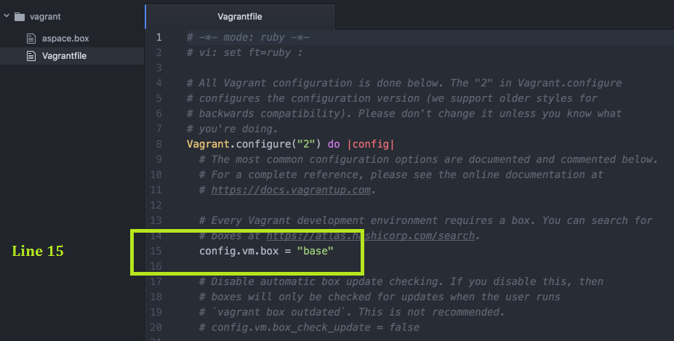
Everyone
Open vagrantfile with Atom text editor and find line 15
PC users right-click; MAC users ctrl + click

Slide 49
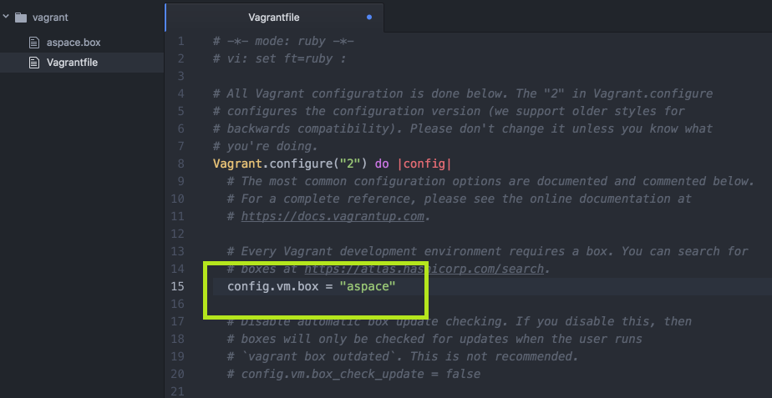
Everyone
Change “base” to “aspace” on Line 15

Slide 50
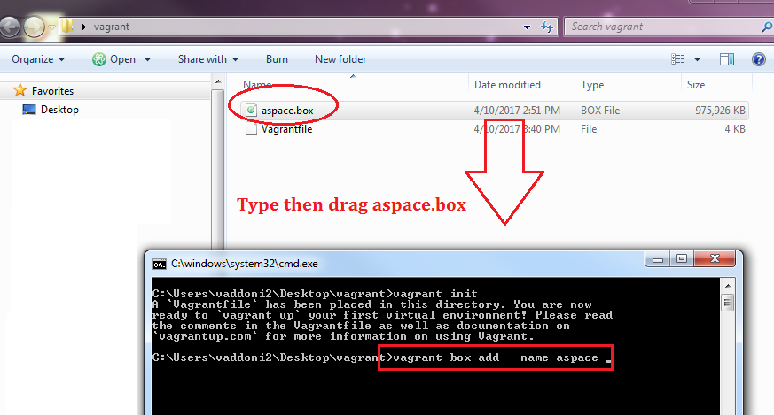
Everyone
vagrant box add --name aspace

Slide 51
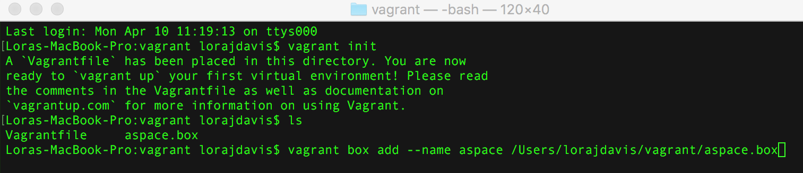
Everyone
vagrant box add --name aspace

Slide 52
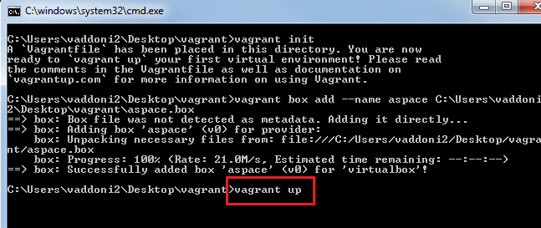
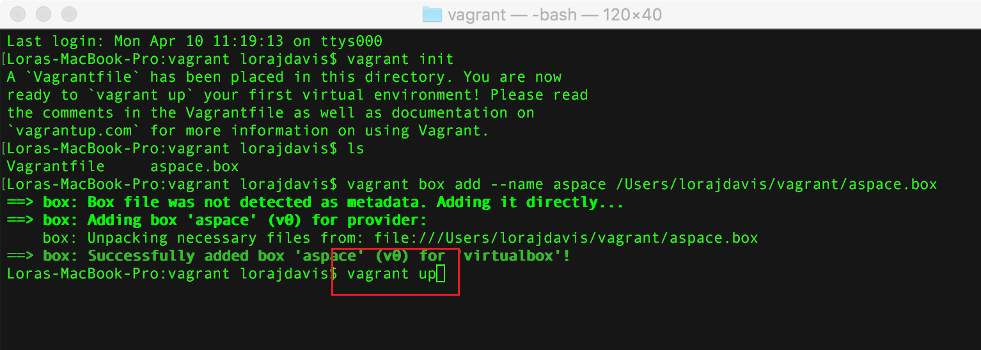
Mac
PC
vagrant up

Slide 53
Open browser, navigate to:
http://localhost:8089

Slide 54
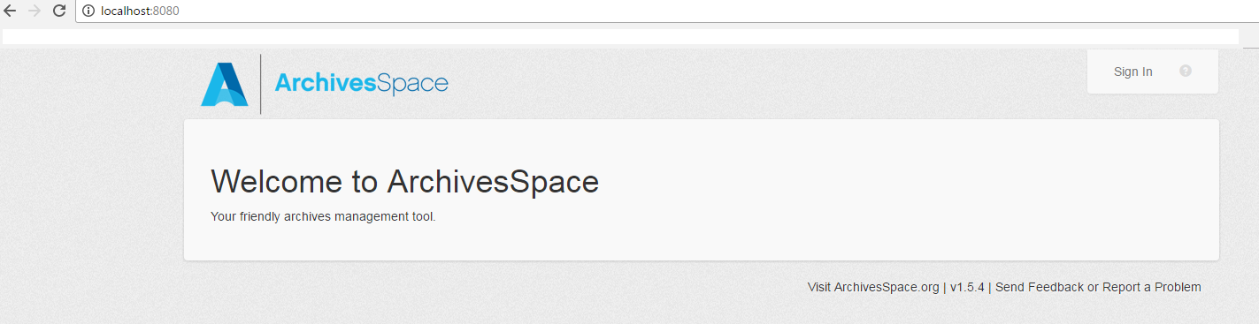
http://localhost:8080

Slide 55
Lunch!

Slide 56
http://localhost:8089

Slide 57
1:15-2:30 ASpace

Slide 58
Everyone:
Navigate to https://github.com/jhu-archives-and-manuscripts/MARAC_API_Workshop
Clone or download > Copy to clipboard

Slide 59
Mac
PC
Ctrl+click on Desktop > New Terminal at Folder
Type git clone [ctrl-click > paste]
Open cygwin
Type git clone [right-click > paste]

Slide 60
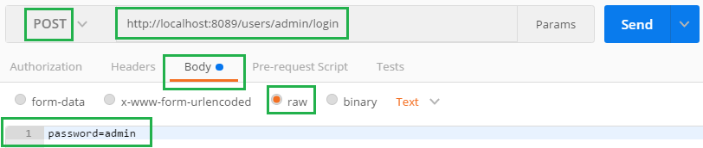
Endpoint: http://localhost:8089/users/admin/login
password=admin

Slide 61
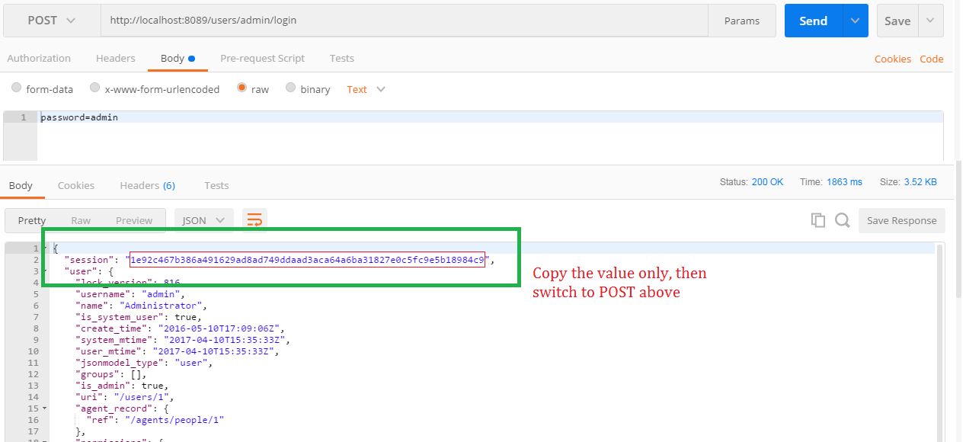

Slide 62
Transforming data
Get data out
Do something to it
Put it back in
Access
OpenRefine
XSLT
Custom script (your choice)
Find and Replace
Hand encoding, copy and pasting, glue and popsicle sticks, whatever it takes!
*sound of the needle coming off the record*
This is the tough part.
JSON
MARC21
Any standardized data

Slide 63
Link container profiles
Navigate to: localhost:8089/container_profiles
Determine the URI for the container profile you wish to link to

Slide 64
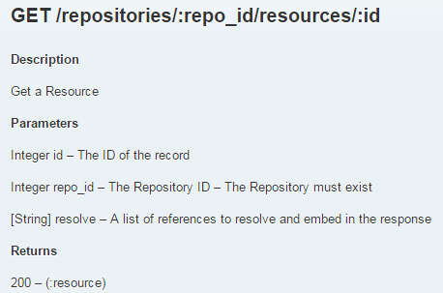
Interpreting API endpoints
http://archivesspace.github.io/archivesspace/api

Slide 65
Interpreting API endpoints
http://archivesspace.github.io/archivesspace/api

Slide 66
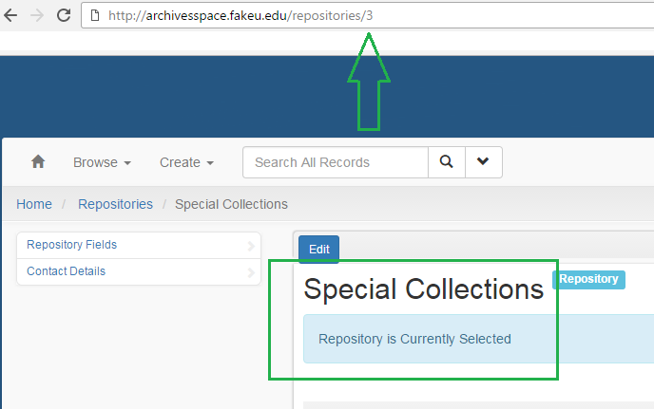
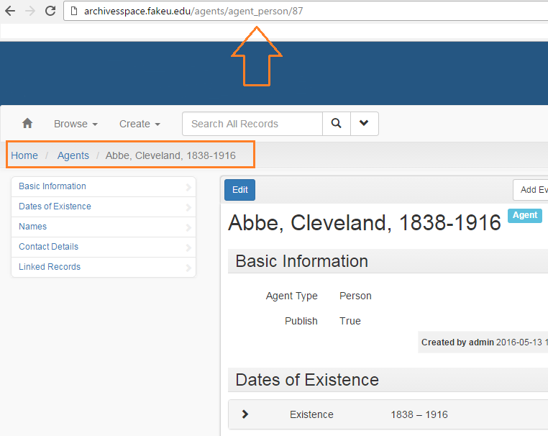
Interpreting API endpoints
The interface — just another lens on the same data — is helpful for constructing API requests.
Determining the repository number:
Determining an agent number:

Slide 67
Default endpoint: http://localhost:8089/repositories/:repo_id/resources/1
Example endpoint: http://archivesspace.fakeu.edu:8089/repositories/3/resources/1
http://localhost:8089 | The address of your instance of ASpace. You will ONLY replace “local host,” the colon and port number remain. EX. http://archivesspace.fakeu.edu:8089
/repositories | The presence of “repositories” here means that this endpoint is repository-specific. Some non-repo specific requests in AS are for Agents and Access Points, which span all of AS. EX. http://archivesspace.fakeu.edu:8089/agents
/:repo_id | The presence of this colon means this value will be unique to your institution. How can you determine the repository number? You can use the repo endpoint, or, from within AS navigate Systems > Manage Repositories > select repository > and look at the address bar. EX. http://archivesspace.fakeu.edu:8089/repositories/3
/resources | Other examples are /accessions or /top_containers. EX. http://archivesspace.fakeu.edu:8089/repositories/3/accessions
/1 | The first resource. How can you determine resource numbers? Navigate to the resource in the interface and its number will be in the address bar. EX. http://archivesspace.fakeu.edu:8089/repositories/3/resources/1

Slide 68
User stories

Slide 69
Can the API create reports?
Yes… but an API is the wrong tool for reporting
Like using a jack-hammer indoors: yes it will work, but it will be more effort with the wrong tool
For AS users in particular:
Wait for reporting to improve, because it will
But in the meantime (or for more customizing reporting) we suggest connecting AS to MS Access.
Credit to Nancy Enneking, Head of Institutional Records at the Getty and Celia Caust-Ellenbogen, Friends Historical Library of Swarthmore College for the method
You can find Celia’s slides in the workshop GitHub > additional resources
If you don’t know Access, it’s easier to learn that than learning to script just for reports

Slide 70
Transforming data
Converting these JSON search results to a CSV (spreadsheet) took less than 10 seconds.

Slide 71
Transforming data
...but you may be more interested on converting it the other way, i.e. how to get stuff back into JSON.

Slide 72
Transforming data
Get data out
Do something to it
Put it back in

Slide 73
Break

Slide 74
Thanks
The vagrant developed for this workshop was adapted by Lora Davis from Dallas Pillen’s Archivagrant. See his blog post for more information about Archivagrant: http://archival-integration.blogspot.com/2016/01/archivesspace-vagrant-archivagrant.html

Slide 75
End

Slide 76
Transforming data
Get data out
Do something to it
Put it back in
We are here

Slide 77
Transforming data
Get data out
Do something to it
Put it back in
We are here

Slide 78
Manual
Manual
Manual
Get data out
Do something to it
Put it back in

Slide 79

Putting it back in
it·er·a·tion
ˌidəˈrāSH(ə)n/
noun
the repetition of a process or utterance.
repetition of a mathematical or computational procedure applied to the result of a previous application, typically as a means of obtaining successively closer approximations to the solution of a problem.
Lock version - a value that incrementally increases every time an AS record is altered. In practice, this means work cannot and should not continue on the data in question, i.e. your team has to stop work

Slide 80
Putting it back in
Requires scripting
Huge barrier to entry for most users
Most devs will say, “Just Google it,” Valerie says, “Google what? I don’t know the question for the answer.”
“All our scripts are up on GitHub!” - the least-most helpful statement you’ll hear
This is extremely helpful
But do you know why? I didn’t.

Slide 81
Transforming data
Communication between systems
Manual to semi-automated
Get data out
Do something to it
Put it back in
System 1
Magic
System 2

